Slide 1
IMDB Movie Analysis
By Deepak soni

Slide 2
Contents:
Project Description
Approach
Tech-Stack Used
Insights
Result

Slide 3
Project Description:
The dataset provided is related to IMDB Movies. A potential problem to investigate could be: "What factors influence the success of a movie on IMDB?" Here, success can be defined by high IMDB ratings.
The impact of this problem is significant for movie producers, directors, and investors who want to understand what makes a movie successful to make informed decisions in their future projects.

Slide 4
Approach:
Five 'Whys' Approach: This technique will help you dig deeper into the problem. For instance, if you find that movies with higher budgets tend to have higher ratings, you can ask "Why?" repeatedly to uncover the root cause. Here's an example:
Q: "Why do movies with higher budgets tend to have higher ratings?"
A: They can afford better production quality.
Q: "Why does better production quality lead to higher ratings?"
A: It enhances the viewer's experience.
Q: "Why does an enhanced viewer experience lead to higher ratings?"
A: Viewers are more likely to rate a movie highly if they enjoyed watching it.
Q: "Why are viewers more likely to rate a movie highly if they enjoyed watching it?"
A: Positive experiences lead to positive reviews.
Q: "Why do positive reviews matter?"
A: They influence other viewers' decisions to watch the movie, increasing its popularity and success.

Slide 5
Tech-Stack Used:
Microsoft Excel 2021 — A spreadsheet editor software used mainly by professionals to enter data in table format, perform computations, plot graphs etc. Here Microsoft Excel is used to filter data and plot graphs to get insights about IMDB MOVIES analysis project.

Slide 6
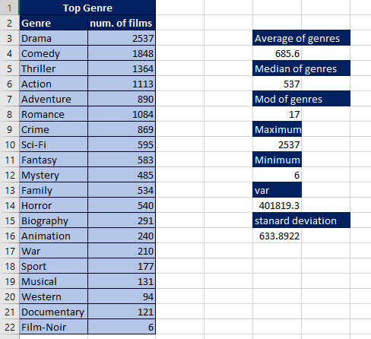
Movie Genre Analysis:
Q -> Determine the most common genres of movies in the dataset. Then, for each genre, calculate descriptive statistics (mean, median, mode, range, variance, standard deviation) of the IMDB scores.
A-> Here we identified top most genres and calculated their descriptive statistics.

Slide 7
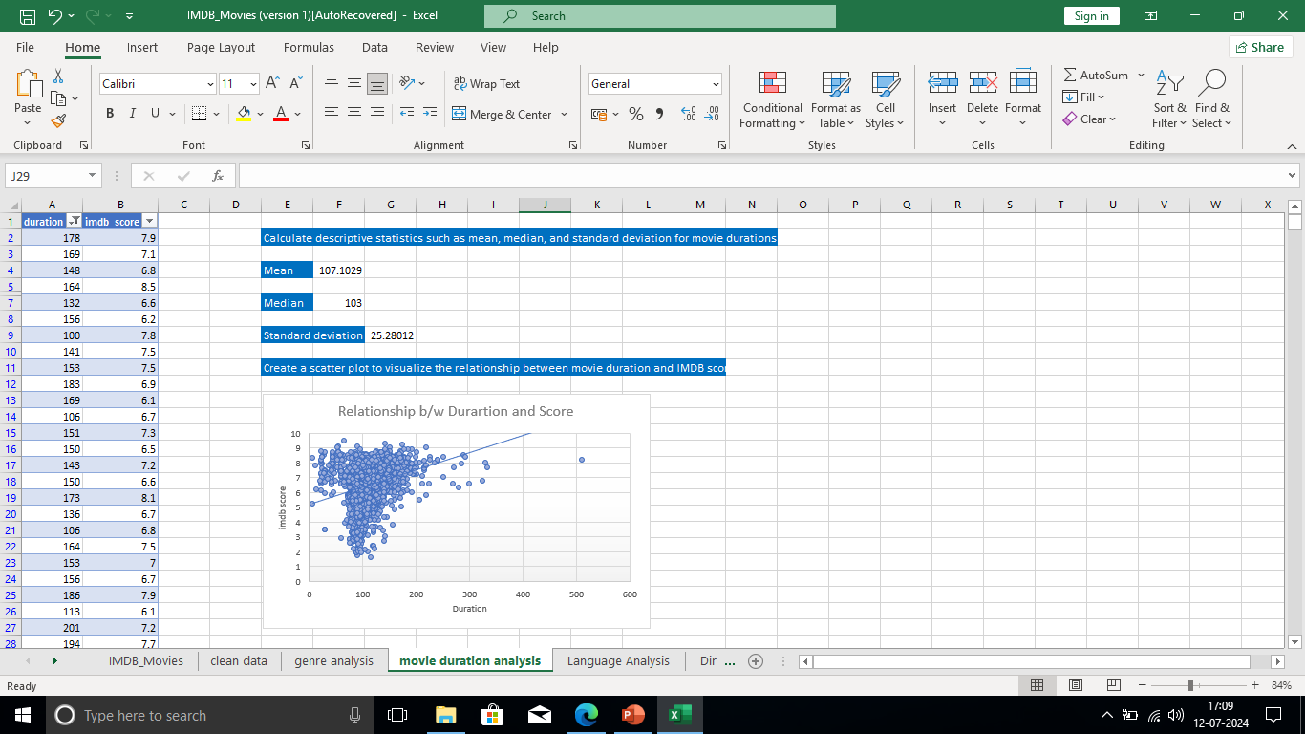
Movie Duration Analysis
Q -> Analyze the distribution of movie durations and identify the relationship between movie duration and IMDB score.
A -> Here we Calculate descriptive statistics for movies duration and Created a scatter plot to visualize the relationship between movie duration and IMDB score.

Slide 8
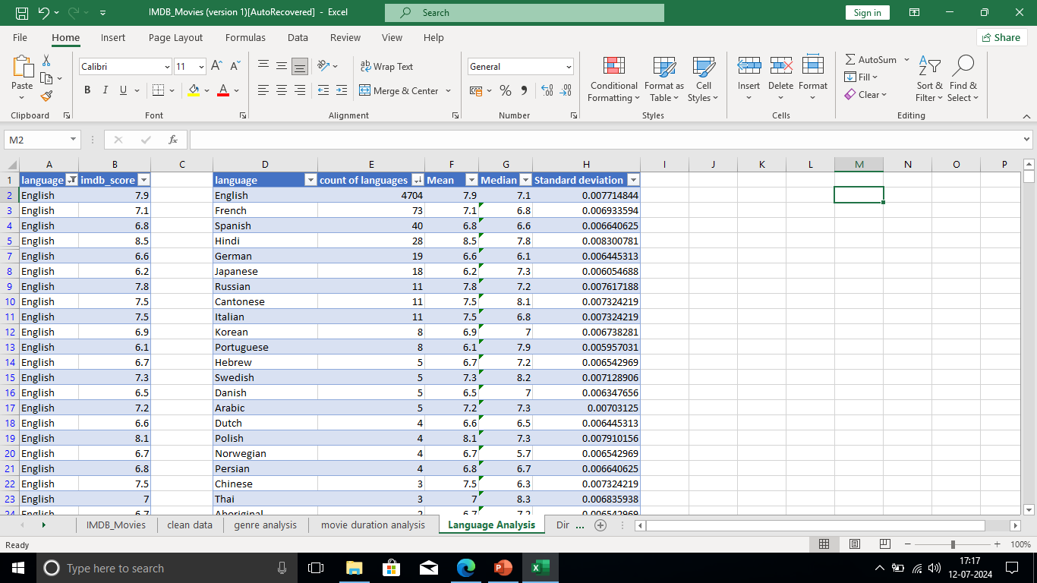
Language Analysis
Q -> Determine the most common languages used in movies and analyze their impact on the IMDB score using descriptive statistics
A -> we use Excel's COUNTIF function to count the number of movies for each language and Calculate the mean, median, and standard deviation of the IMDB scores for each language.

Slide 9
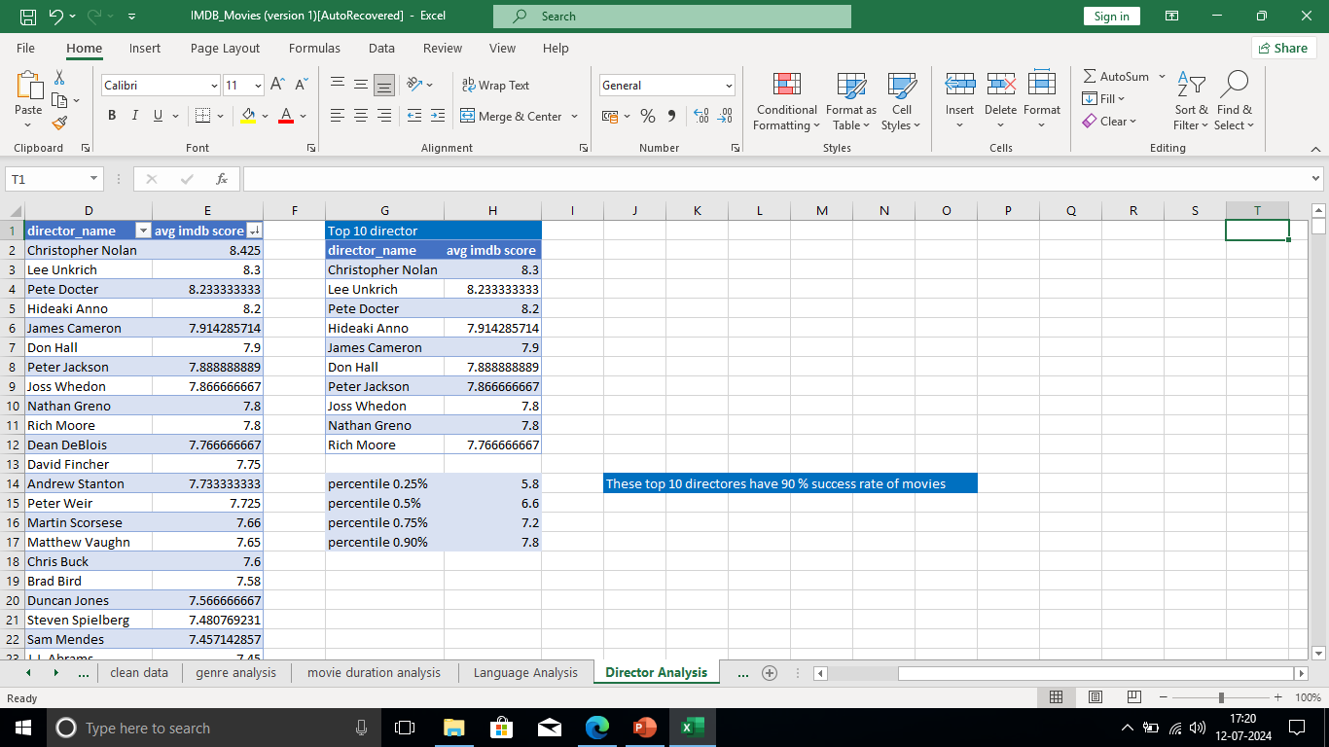
Director Analysis:
Q -> Identify the top directors based on their average IMDB score and analyze their contribution to the success of movies using percentile calculations.
A -> we have calculated the average IMDB score for each director. Uses Excel's PERCENTILE function to identify the directors with the highest scores and Compare the scores of these directors to the overall distribution of scores.

Slide 10
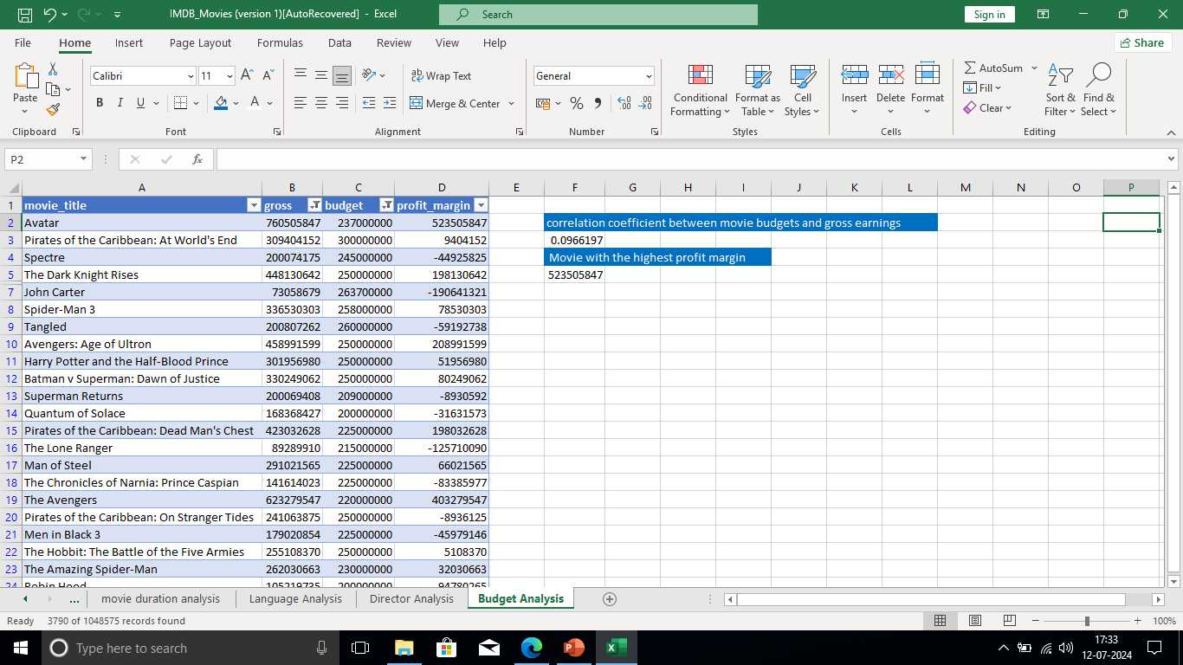
Budget Analysis:
Q -> Analyze the correlation between movie budgets and gross earnings, and identify the movies with the highest profit margin.
A -> Calculated the correlation coefficient between movie budgets and gross earnings using Excel's CORREL function and calculated the profit margin (gross earnings - budget) for each movie and identifed the movies with the highest profit margin using Excel's MAX function.

Slide 11
Results:
In this project of IMBD Movie Analysis, I have gained various Logical, Statistics and Technical Skill for get desired answers from the dataset.
My ability to apply statistics and Microsoft Excel's technical capabilities to analyse data. It speeds up data analytics tasks considerably. simplifies difficult and time-consuming calculations. I also get a sense of how visual representation of data makes it very simple to understand through its data visualisation functionality.

Slide 12
Thank y u

